Slide 1
The Millionaire Next Door
William D. Danko, Ph.D.
Thomas J. Stanley, Ph.D.

Slide 2
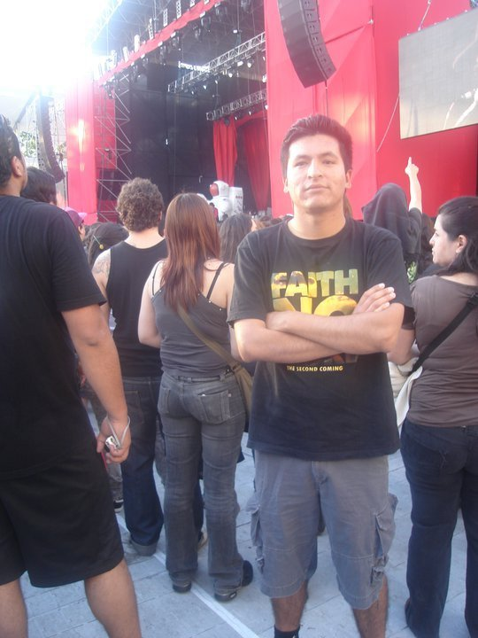
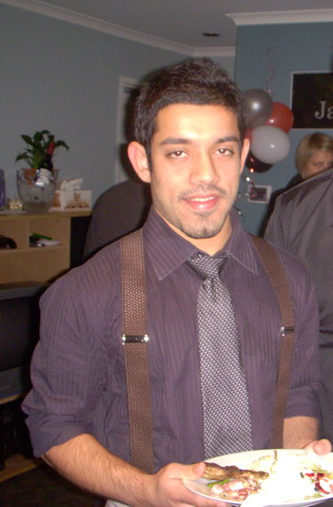
Jaime vs Nakul-Who looks like rich?

Slide 3
Big difference between looks like and be?
Jaime | Nakul
1. He has always been able to help others. Sponsored his younger brother’s education. | 1. Never able to lend more than 500 dollars at a time.
2. Saved and invested early in property. Property gives him rent and he lives in a one bedroom house in Calama, Chile | 2. Nakul is good on saving on rental expense, but spends a lot and has lived 8 years almost on pay check to paycheck.
3. He can and has taken multiple pay cuts and is not worried | 3. Out of a job is a big worry. No control over expense.
4. He saves on tax return and minimises it. | 4. Nakul waits for tax refund to kick in to use it buy something or travel.
5. He used to be like Nakul, until he read and made some changes based on the millionaire next door. | 5.Nakul started making some progress last year, based on Felipe’s recommendation of putting some money towards vanguard. Now wants to be more like Jaime.

Slide 4
Who is likely to be a millionaire?
Is it Mrs Rose who earns $300,000 a year or is it Mrs Linda who earns $90,000 a year?
It’s the one who can accumulate more wealth.
Mrs Rose spends $290,000 a year, Mrs Linda spends $40,000 a year
Mrs Linda is able to save $40,000 a year more than Mrs Rose
If Mrs Linda loses a job after 10 years, she can continue 400,000/50,000 upto 10 years.
Mrs Rose will be out in few months.
The formula represented in book is Your age*Income/10. Do you have this money saved/invested somewhere. Are you below this then you are a UAW else a PAW.

Slide 5
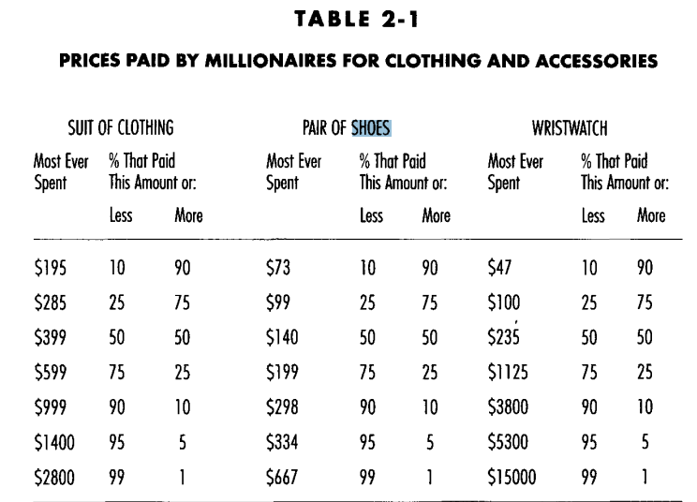
You should be a PAW rather than an UAW
They live below their means. They save a good amount of their income.
Less than 50% paid $399 or less on suits, $140 or less on shoes, $235 or less on wrist watch. 14% in this sample inherited the wealth. The inheritor paid almost 80% more on suits.
Would you like a glass of 1970 Bordeaux? No I drink two types of beer free or budwiser. The decamillionaires do not want to touch vintage wine.
They are goal oriented. They budget and control.
Mrs Linda knows every penny of the expense.
Nakul’s goal is to retire in 10-16 years. Yearly goal of $40,000 saving. Fortnightly goal of $1,600 saving.
They spend lot of time and energy in financial planning.

Slide 6
Living below the means
What is by biggest regret?
I lived paycheck to paycheck for 8 years.
I did not start earning early, because my dad wanted best for me and he said after uni you can work. I started at 21, I wish would have started at 16. I am on annual average $8,000 behind based on average income of $30,000.
The PAWS spend way below their income (include partners and children).
They don’t spend money on weekend parties.
They don’t have a feast for breakfast, lunch and dinner.
They don’t buy premium foods all the time.
Now I understand why Felipe would settle for a glass of red label.
Why Nakul’s father only drinks black label.
Why he never bought shoes more that $30, doesn’t own a wrist watch, and highest suit spending has been less than $150.

Slide 7
Goal oriented and control
When you know you want to lose 10 kgs in next year.
Montly goal of 0.85 kgs a month
Weekly basis 200 grams
Nakul wants to retire in 15 years, what does that mean.
Just goal is not enough.
How much do I spend on groceries, gifts, parties, car etc.
$40,000 is a good number, but how certain am I that I will meet it without controlling and measuring underlying habits. Some millionaires have done it without controlling but majority of them know each penny’s detail.

Slide 8
Time and Energy
Why Ivan is a great data scientist?
Why William never gets fat and has not to worry about calories?
Why Tim Ferris has his podcast show with so many followers?
They all have dedicated time and energy into it
Staying fit in their goal has become part of their role and dream
So PAWs spend almost twice as more time than UAWs monthly on being financially fit. But if we quantify in hours in a month and extend that to hours in a year and hours in a lifetime, you can quantify why did they accumulated more wealth
Personally spent 10 hours this week, meeting property managers and new type of real estate models.

Slide 9
Why people aren't doing it?
Everyone wants to be millionaire?
They have the wrong perception?
Have their habits been spoilt?
Fear the government change?
Fear economy crash?
Fear of apocalypse?

Slide 10
How to PAWs accumulate wealth?
Who is the biggest customer of your money? ATO.
Governments have high debt, they love high earning data scientists who are not investing money and are high consumers of your salary. They have studied this market well.
PAWs are biggest enemies of ATO. They work with unrealized income.
They reinvest in their business
They invest in tax free bonds and stocks
They buy company stocks for salary sacrifice and enjoy dividend yields
They look for opportunities
What can you do with your money?
https://www.moneysmart.gov.au/investing/invest-smarter/choose-your-investments/make-tax-work-for-you

Slide 11
What can we learn from PAWs
They know where other accumulators are putting their money. They research the market.
They invest in real estate, they own farm lands, etc. They invest in commercial properties, one of the most successful done by my dad.
They pay big money to their financial planners/CPA/CA to help manage investments, to know about other successful investors and to save tax. Atleast invest 15% pre tax. Super accumulators reduce their tax significantly and contribute maximum 9% of their total wealth.
They make their children independent, teach them to be frugal (Anti-ECONOMIC OUTPATIENT CARE ). They don't give them money as asked. The more you give, more likely the children will spend all and accumulate less. Their has been research done on the high accumulators, they come from developing countries seen the poor conditions and want to change that.
Half the millionaires never paid for $30,000 on motor vehicles. They go for highly accessible market (ford, toyota, holden). They know that new car value will drop 15-40% straight out of showroom, so why not buy a car that has run 100,000 kms and is second hand.
UAWs worry more that PAWs. Biggest difference. As data scientists if we could worry less. This means better health, better quality of life.

Slide 12
Niche POWs and Super POWS are not frugal with:
Health/Dentistry. Apparantly don’t want their skin and teeth look bad when they retire.
They invest in their business. They are true marketeers of their business. Why hugry jacks grew, but a local fish and chips doesnt grow. I bet local fish and chips have a better steak sandwich.

Slide 13
Implications for us
Financial independent
Ability to take a pay cut and have a start up
Not feel burdened at job or have to listen to a boss due to financial pressure.
How to invest by reducing income tax?
Invest in tax free bonds, super contributions, municipals, tax sheltered real estate etc. Can I dedicate some income to anz dividend stocks?
Richard to do this session and it’s a team’s problem.
We can be bit transparent with each other and talk about this

Slide 14
Implications for Analytics
What are those factors in a company that makes them an actual consumer. Is their office too lavish, are the stores and operating expense very high?
Companies that don’t plan, no technology in retail to improve supply chain or reduce costing through online stores, these companies don’t spend enough time planning their future. What should be their credit rating?
Who is that ultimate consumer, that don't invest, have high income and have a lavish lifestyle - Can bank reach out to them, and suggest financial management. Can these profiles be recommended to companies. Its their premium customer.
As we grow affluent and wiser with money, we will understand more where to invest and who to invest with. What if in data where the style of a company owner and hos behavior be a feature of a credit model and performance of the company.

Slide 15
Thank you
Nakul Bajaj

